Slide 1
Invoicing – How to pay Use Tax (Reporting Tax) to a governmental vendor when paying invoice
Yoel Kortick – Senior Librarian

Slide 2
  What is "Use Tax"?
  Liable for VAT
  The "Governmental" Vendor
  Create and Pay the Original Invoice
  See the Report Tax Invoice Get Automatically Created
  Expenditures Specifically for the Use Tax

Slide 3


What is "Use Tax"?

Slide 4
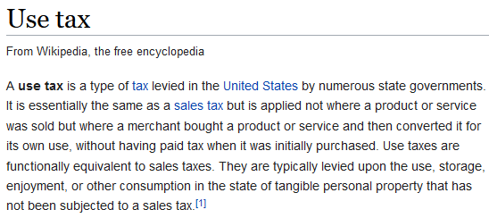
What is "Use Tax"?
https://en.wikipedia.org/wiki/Use_tax

Slide 5

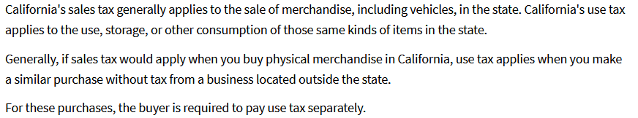
What is "Use Tax"?
https://www.cdtfa.ca.gov/taxes-and-fees/use-tax.htm

Slide 6
What is "Use Tax"?
In Alma it is possible to pay the tax in a separate invoice, typically to a government – associated vendor.
The separate invoice will have the same number as the original invoice, but will also have "_RT_ as a suffix (RT = Reporting Tax)
The _RT invoice includes only the VAT.
Note: In many cases the terms “Use Tax”, “Reporting Tax” and “VAT” are used interchangeably, as different people and organizations have “their own” definitions.

Slide 7
What is "Use Tax"?
The separate invoice for the VAT is created if the following conditions exist:
  The vendor is noted as liable for VAT
  The institution has an associated governmental vendor
  VAT is entered for the invoice
See also: How Alma Handles VAT Payments.

Slide 8

Liable for VAT

Slide 9
Liable for VAT
The "Liable for VAT" checkbox indicates that invoices must be paid with VAT included.
The "Liable for VAT" checkbox must be selected to enable a separately-defined governmental vendor to collect VAT for this vendor’s invoices.

Slide 10
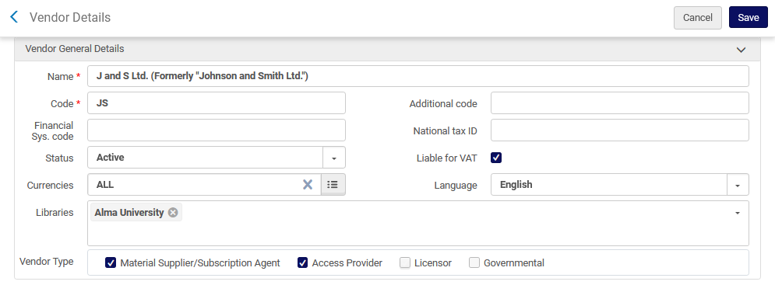
Liable for VAT
Vendor "J and S Ltd." is defined as "Liable for VAT"

Slide 11

The "Governmental" Vendor

Slide 12
The "Governmental" Vendor
If the vendor is marked as “Governmental” then this means that the vendor receives “use tax” (VAT) for an invoice payment from non-governmental vendors. The use tax is expended from the same funds as original invoice charges.
After selecting “Governmental” a TAX Percentage area and field appears. The staff user should enter here a numerical value for the tax to be administered.
The TAX Percentage is the percentage that will be calculated from the PO line amount of the regular invoice (total less discount, not including shipping or other charges) in order to create a special tax-only governmental invoice.

Slide 13
The "Governmental" Vendor
After saving the vendor, the vendor will acquire the attribute of type = Governmental.
The governmental vendor sends a separate invoice containing only the use tax on an invoice's charges, according to the value entered in Tax percentage.
Note that there can be only one active governmental vendor.
On the next slide we will see that the institution has a governmental vendor named “Government tax vendor” with tax percentage 17.0.

Slide 14
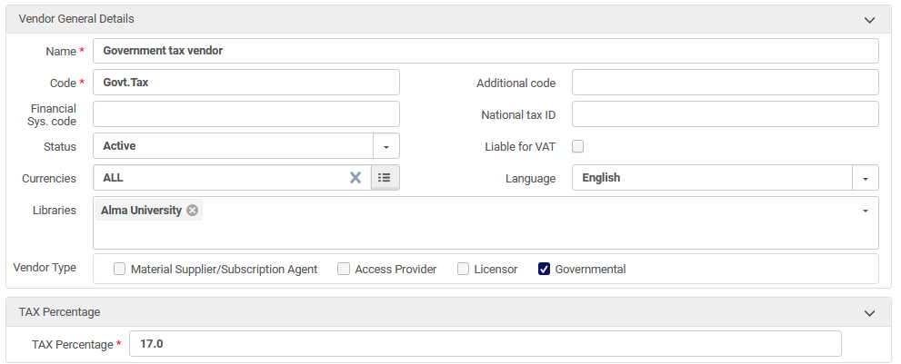
The "Governmental" Vendor

Slide 15

Create and Pay the Original Invoice

Slide 16
Create and Pay the Original Invoice
We will now create an invoice for PO-217713 which has a total cost of 100.00 EUR.
PO-217713 is for vendor “J and S Ltd.” which we saw has “Liable for VAT” checked.
The PO is on the next slide

Slide 17
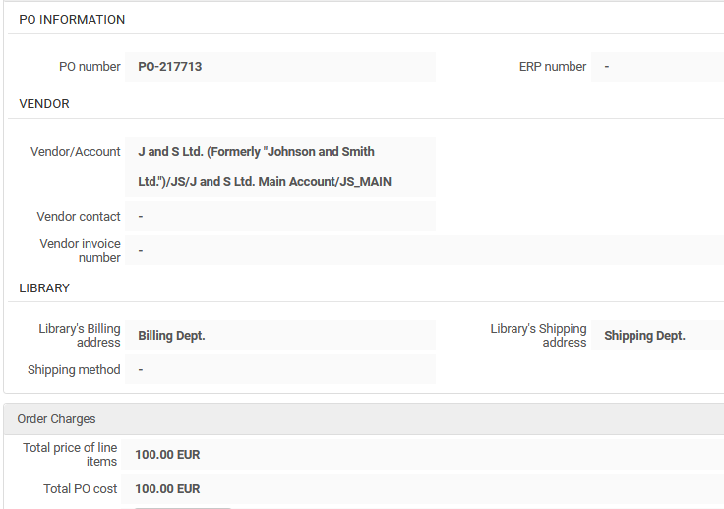
Create and Pay the Original Invoice

Slide 18
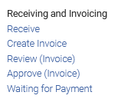
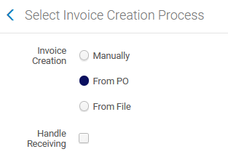
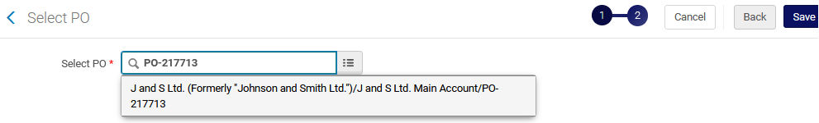
Create and Pay the Original Invoice
Create the invoice from the PO

Slide 19
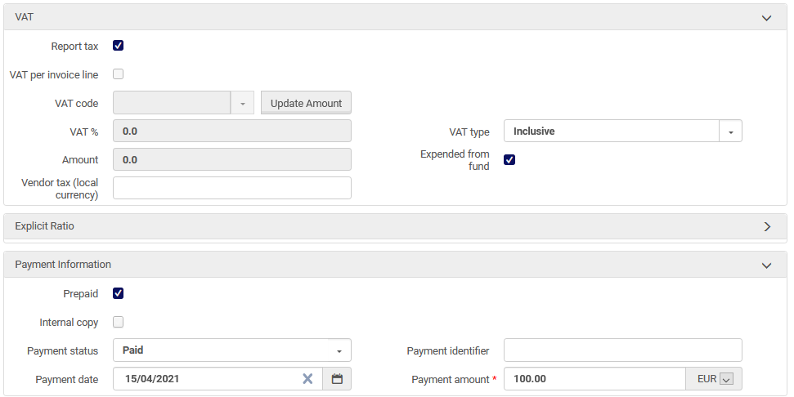
Create and Pay the Original Invoice
In the invoice we specify “Report tax” and pay the 100 EUR
After checking “Report tax” the fields “VAT per invoice line” and “VAT Code” are disabled

Slide 20

See the Report Tax Invoice Get Automatically Created

Slide 21
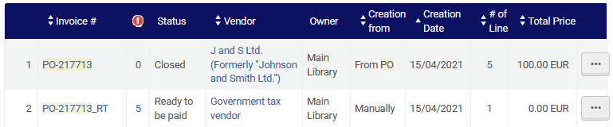
See the Report Tax Invoice Get Automatically Created
In addition to the invoice PO-217713 another invoice is created with suffix _RT. The invoice with suffix _RT is generated automatically by the system when first invoice is paid and closed.

Slide 22
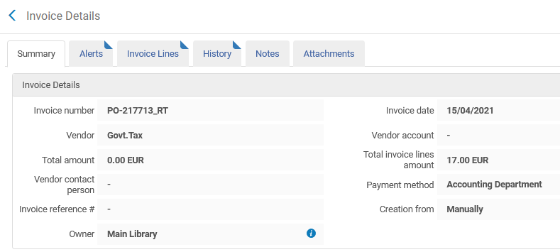
See the Report Tax Invoice Get Automatically Created
The “_RT” has total invoice lines amount 17.00 EUR (17% of the 100.00 EUR total of invoice PO-217713, because 17% was defined for the governmental vendor).

Slide 23
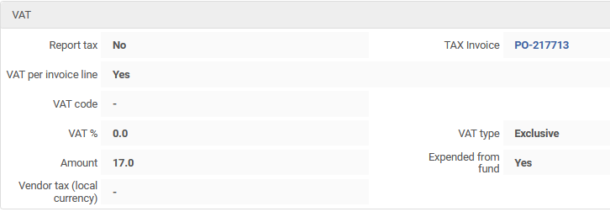
See the Report Tax Invoice Get Automatically Created
The 17.00 EUR also appears as the VAT amount

Slide 24
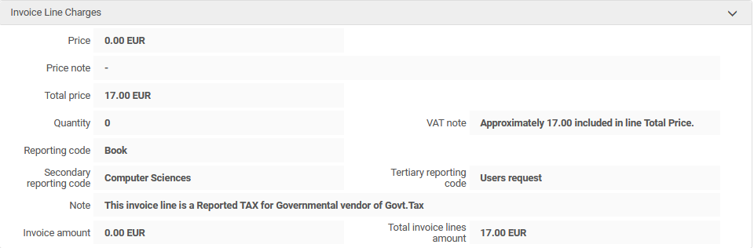
See the Report Tax Invoice Get Automatically Created
Note that the invoice line of the “_RT” invoice has a note that it is reported tax for government vendor.

Slide 25
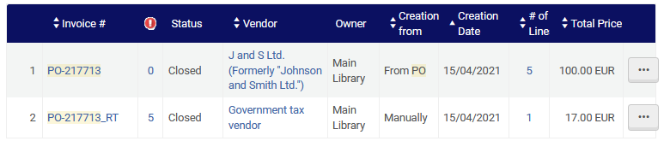
See the Report Tax Invoice Get Automatically Created
The “_RT” invoice has been paid. See that we have both invoices:
PO-217713 is for 100.00 EUR and the PO-217713_RT Reporting tax is for 17.00 EUR (17% of the original).

Slide 26

Expenditures Specifically for the Use Tax

Slide 27
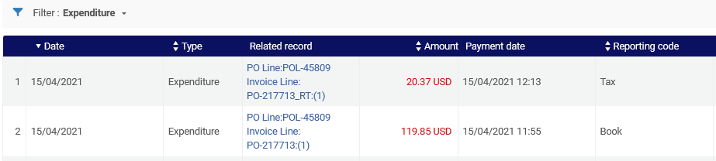
Expenditures Specifically for the Use Tax
We can also see that each ‘Payment” has a separate expenditure on the fund.
It is also possible to use a separate fund for the tax, as in some cases there is a dedicated fund specifically for the tax. In this case the staff user could change the fund in the invoice line, which by default is the same as the fund of the original invoice.
Here we see that 17.00 EUR has been converted to 20.37 USD and 100.00 EUR has been converted to 119.85 USD.

Slide 28
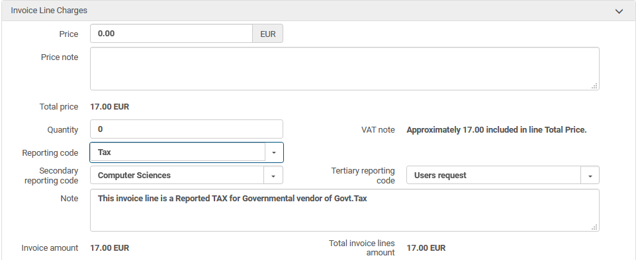
Expenditures Specifically for the Use Tax
It also possible to use a reporting code such as “Tax” on the invoice line which is for the VAT. These invoice lines can be retrieved in Alma Analytics by ‘Reporting Code = Tax”.

Slide 29
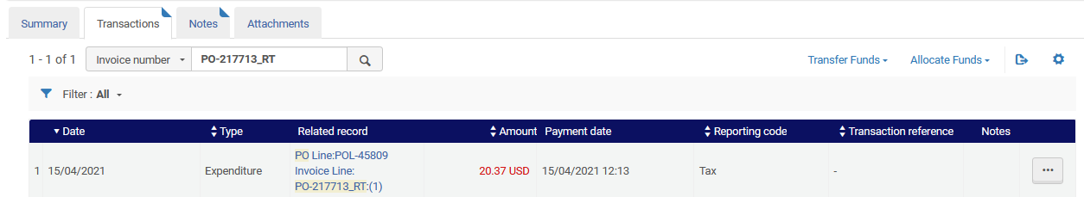
Expenditures Specifically for the Use Tax
The reporting code also appears in the corresponding transaction on the fund

Slide 30
xxx@exlibrisgroup.com

